Slide 1

Empowering Enterprises with Microsoft Fabric The Ultimate Analytics Solution for Onelake & Lakehouse
Nagaraj Sengodan
Notes:
Ver 2023-1119
Presenter's Name
Presenter's Name

Slide 2

Nagaraj Sengodan
Cloud Solution Architect
Specialized in data and AI Consulting, Strategy, Solution Architecture, and Implementation
Expertise in Azure, holding multiple Certifications in Microsoft Azure and Databricks.
https://uk.linkedin.com/in/NagarajSengodan

Slide 3
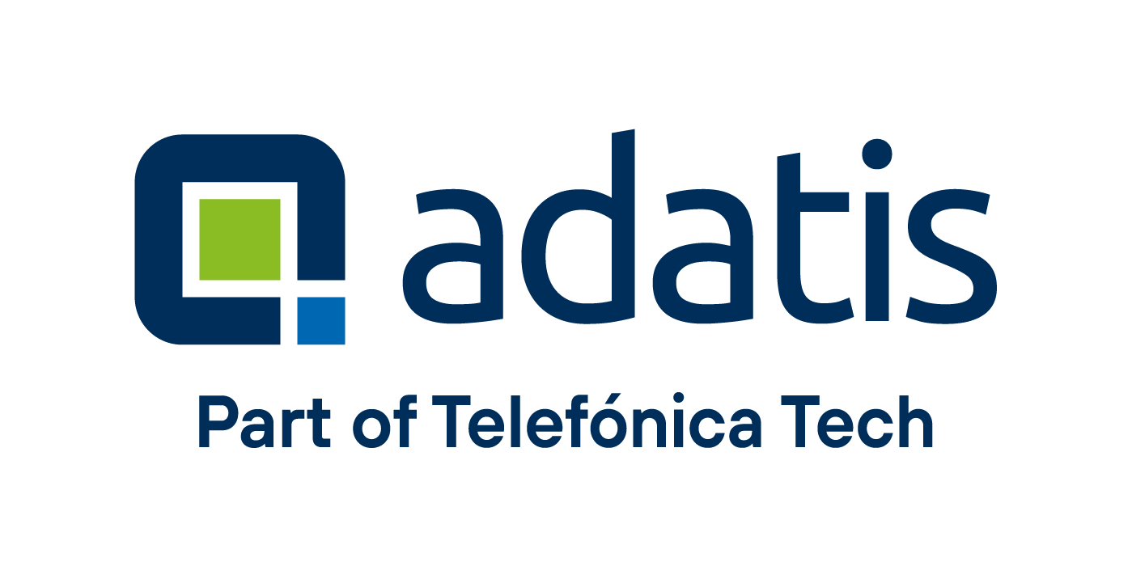

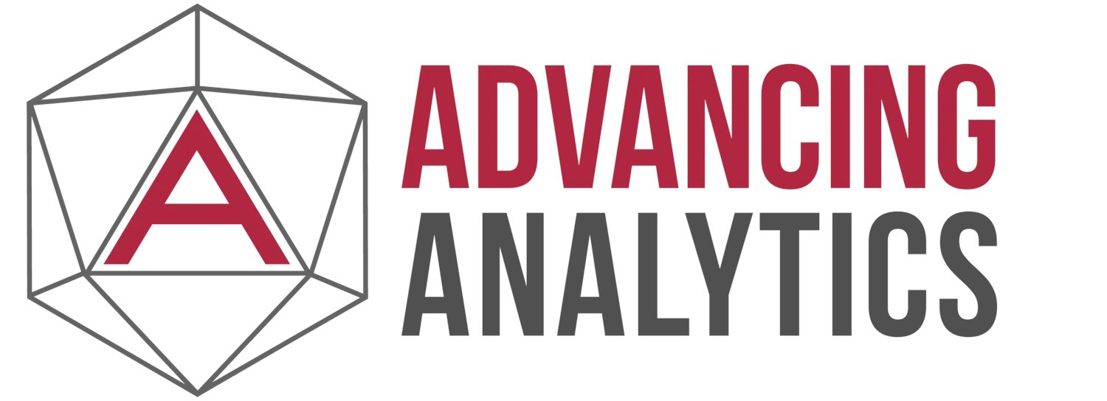

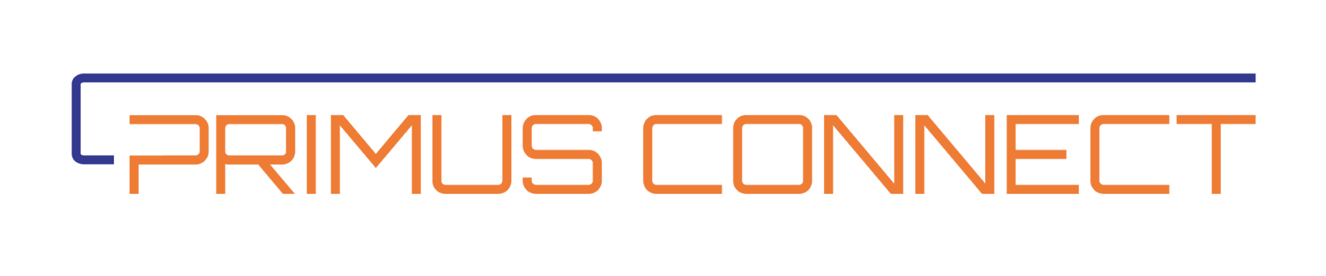
Sponsors – Thank you
We couldn’t do it without you.

Slide 4
Introduction
Enterprises navigate data complexity to thrive in a fast-paced market
Microsoft Fabric offers simplicity through OneLake and Unified Analytics
Let's explore.
Notes:
In today's ever-changing business world, organizations know they need to make the most of their extensive data to gain valuable insights. However, dealing with the challenges of data and analytics can be tough.
"Enterprises navigate data complexity to thrive in a fast-paced market, while Microsoft Fabric offers simplicity through OneLake and Unified Analytics. Let's delve into the details."
Microsoft Fabric is a comprehensive solution designed to address the complex data and analytics challenges faced by modern enterprises.

Slide 5

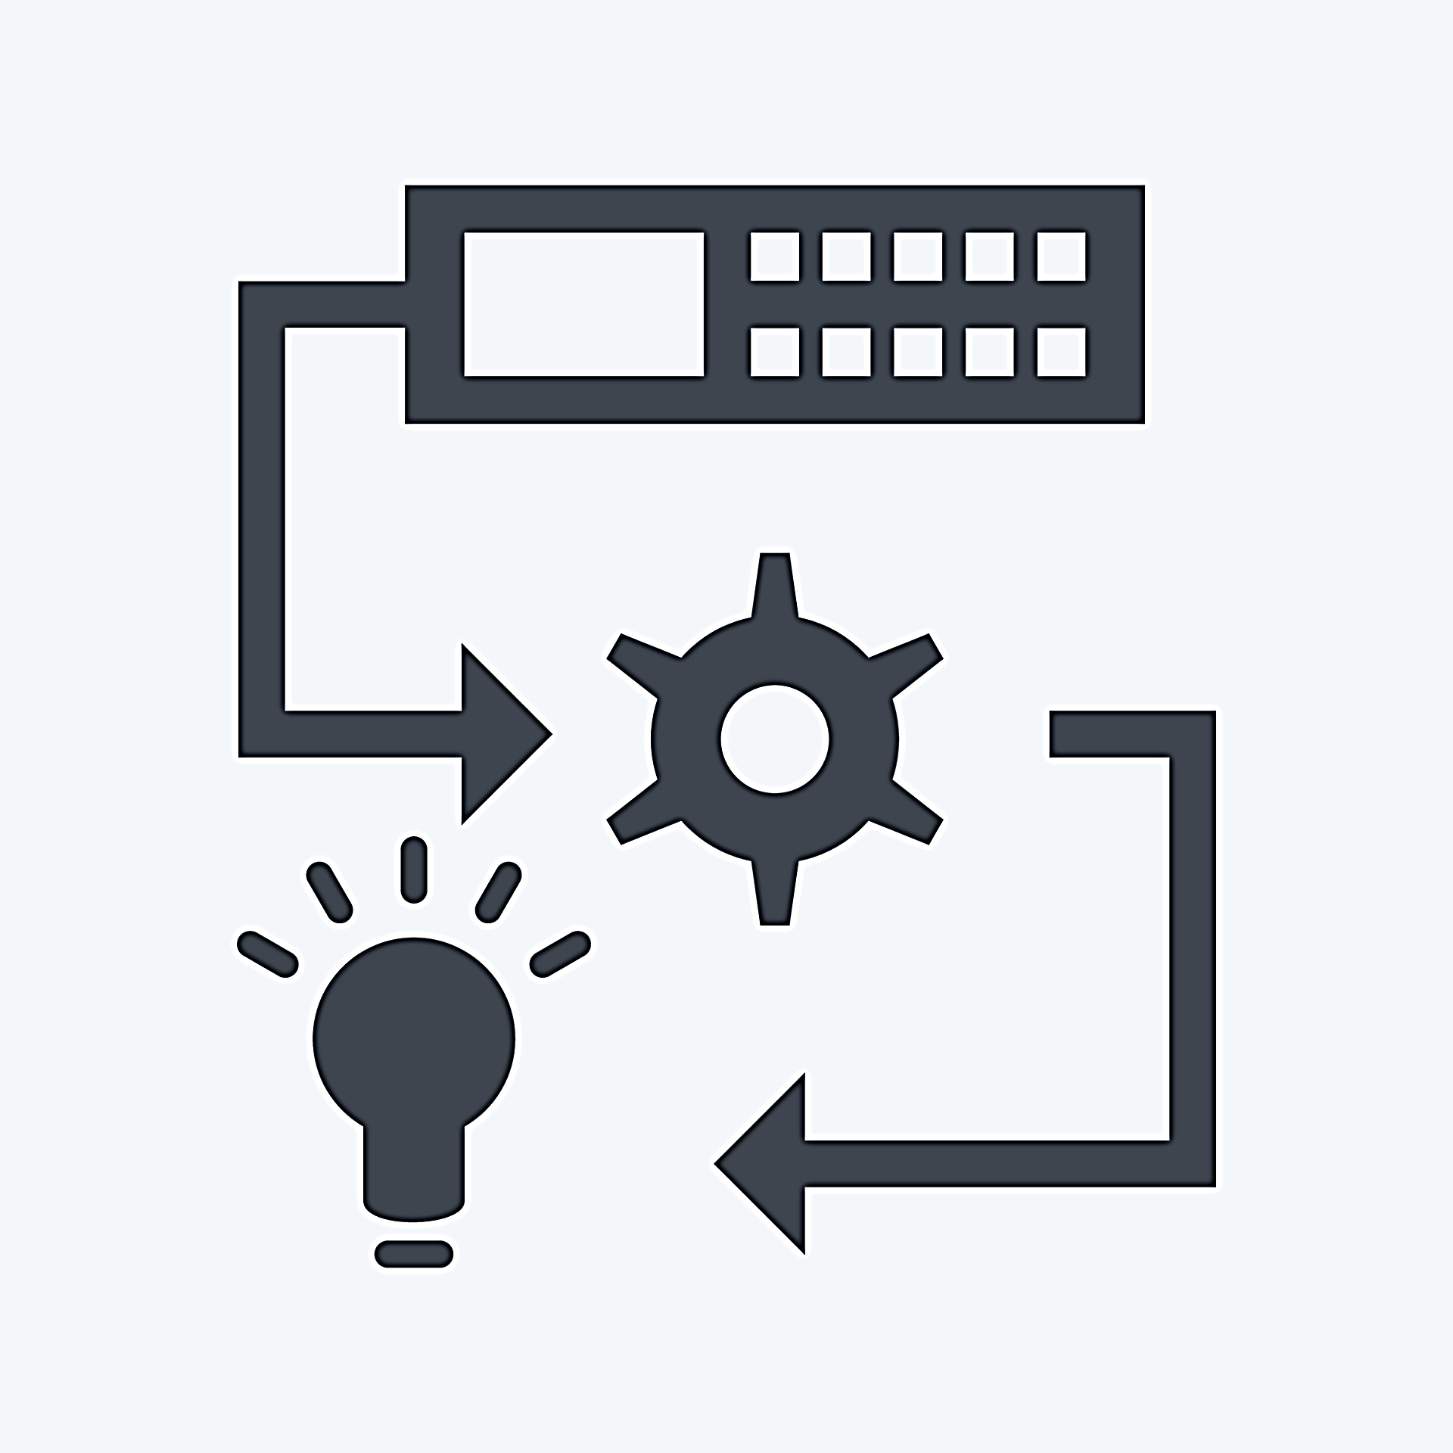

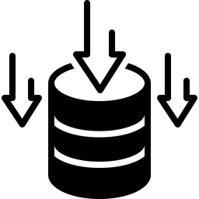
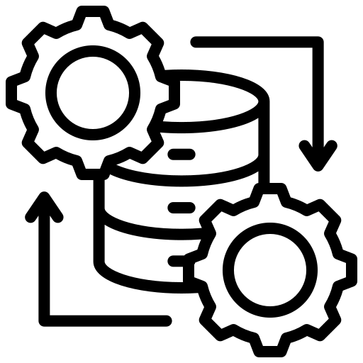

Complexity of Enterprise Data Platform
The complexity of an Enterprise Data Platform arises at every stages. Business agility and ever changing regularity requirement further amplifies the intricacy of managing such a platform
Data Integration
Data Storage
Data Processing
ML & Advanced Analytics
Data Sharing & Visualization
Diverse data sources
Evolving data requirements
Changing data structures
Diverse data sources
Evolving data requirements
Changing data structures
Complex transformation
Data quality
Business Agility
Expertise and Talent
Flexible platform
Data Drift
Data Accessability
Interactive dashboards
Ever growing requriements
Security & Governance
Swiftly adopt regulatory requirements
Data Trust
Distrubuted & Decentralised governance

Slide 6
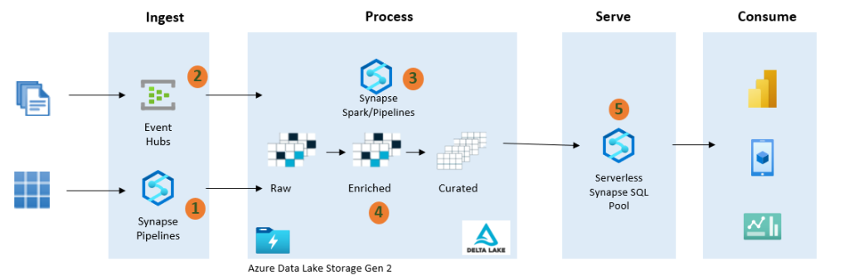
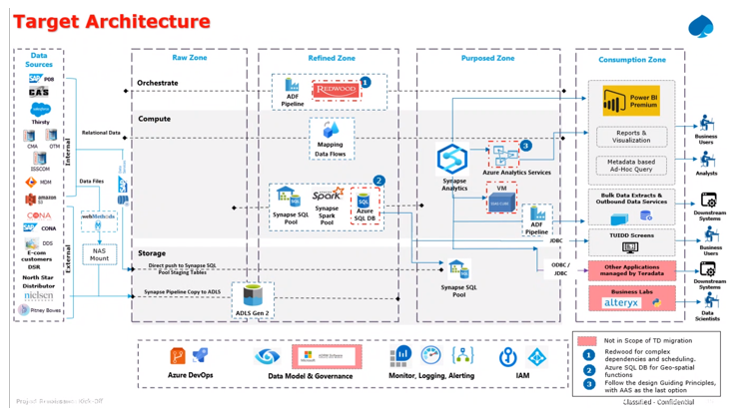
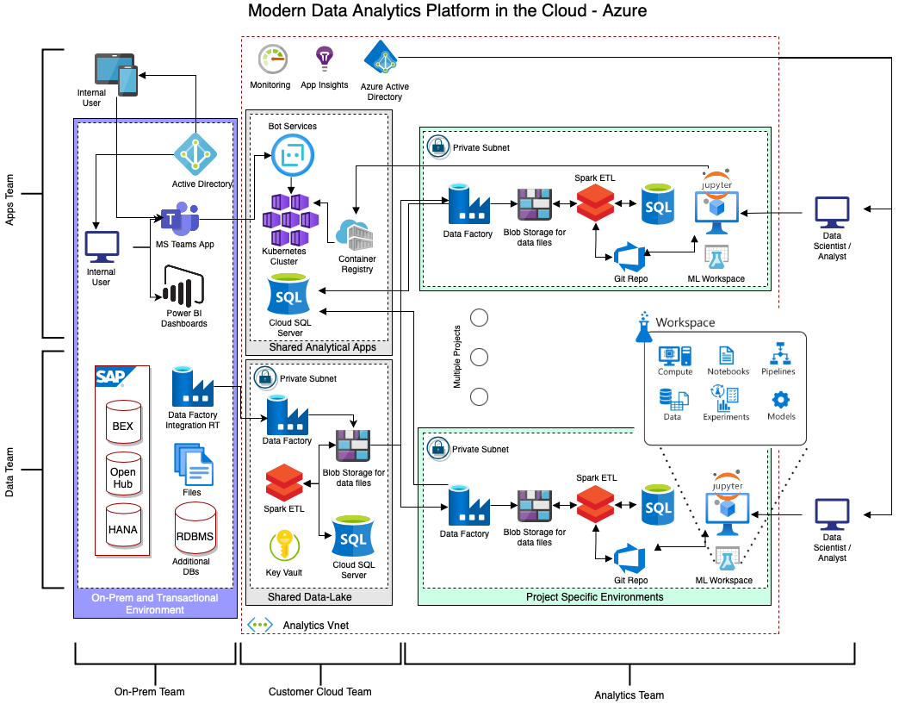
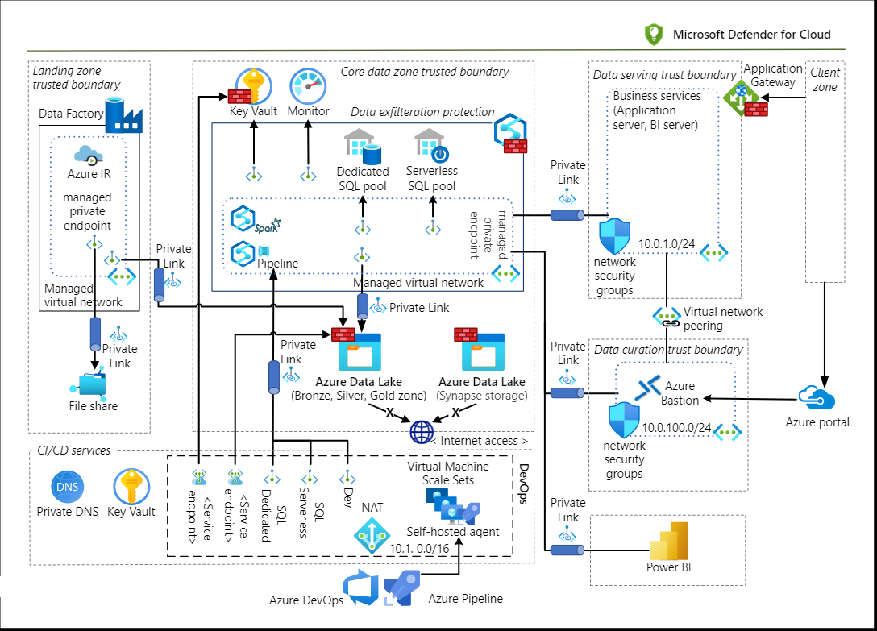
Architecture Complexities
Expected Solution
Expected Solution
Actual Solution with Centralized Approach & Management Overhead
Actual Solution with Decentralized Approach & Hub & Spoke Complexity
Actual Solution with Networking Complexity

Slide 7

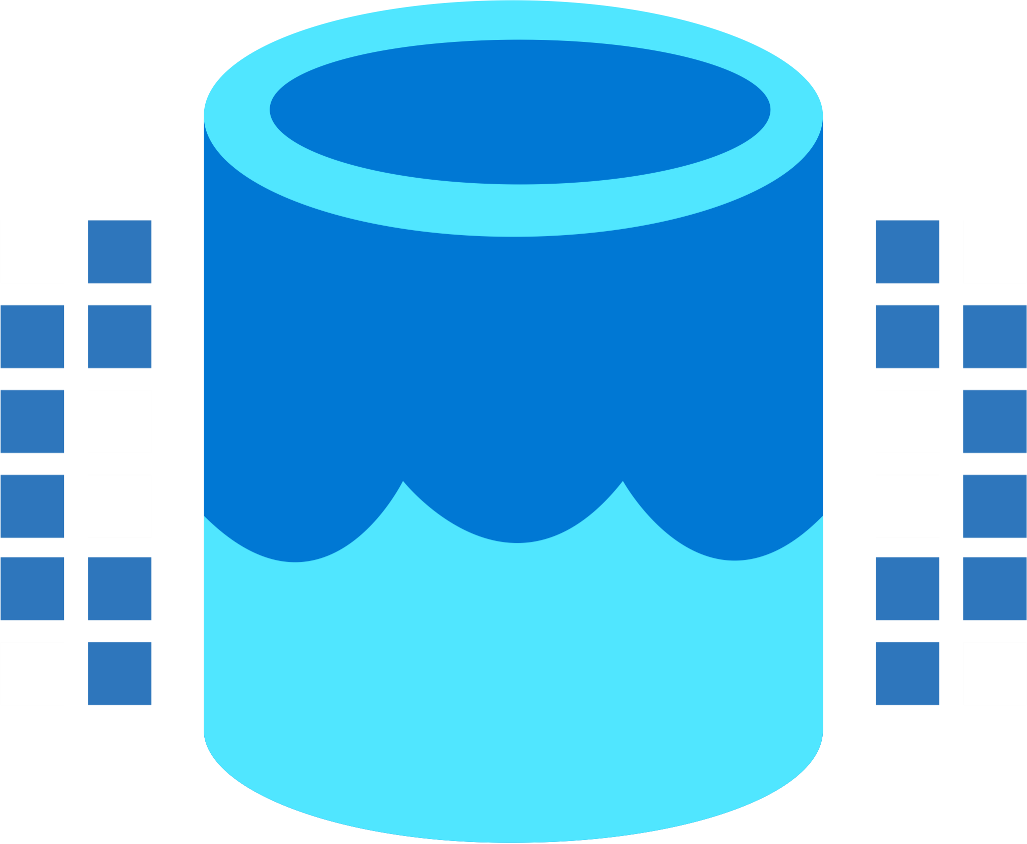
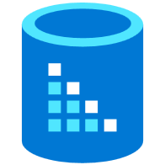

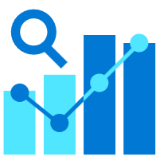

Unified Analytics
Unified analytics platform that brings together all the data and analytics tools that organizations need
Data Integration
Data Lake
Spark Engines
Data
Warehouse
Real Time Analytics
Data
Science
Business
Intelligence
Governance
Unified analytics
End-to-end analytics data fabric
From the data lake to the business user

Slide 8





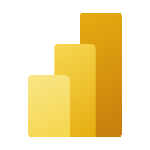





MS FABRIC
A comprehensive solution that meets all your data integration, engineering, real-time analytics, data science, and BI
Data
Factory
Synapse Data
Engineering
Synapse Data
Science
Synapse Data Warehousing
Synapse Real Time Analytics
Power BI
Data Activator
Serverless
Compute
T-SQL
Spark
Event
Streams
Pipelines
Data
Activator
KQL
Distributed compute system with isolation boundary, unparalleled speed and efficiency
OneLake Storage
OneSecurity
Finance
CRM
HR
MDM
Operational
Analytics
Single, unified, logical data lake for the whole organization, simplifying data management and collaboration
Shortcuts
Shortcuts enable easy data sharing, eliminating the data duplication and simplifying data collaboration
Azure
Amazon
Google

Slide 9














Simplified Architecture
Enterprises
Source System
INGEST
PREPARE
TRANSFORM & ENRICH
SERVE
VISUALIZE
FABRIC UNIFIED ANALYTICS
Telemetry
Data Stream
Data
In motion
Eventstream
Power BI
Data Explorer
Data
At rest
Shortcut
Downstream Systems
Local DB Sensor Readings
Local DB Logs
Customer MIS
Data Pipeline
Lakehouse / warehouse
Notebook / Spark Job / Dataflows
Reports & Share Data
Purview Hub
Raw data
Curated data
Model data
Governance / Catalog
STORE
OneLake

Slide 10
FIT THE BILL
SaaSified
Unified
Simplified

Slide 11
Q & A

Slide 12


Thank You…
Feedback
Help us improve
https://forms.gle/FVyh14LGYnXvnPdQ9
Github
Deck and code
https://github.com/KRSNagaraj/Empowering-Enterprises-with-Microsoft-Fabric

Slide 13
Appendix

Slide 14
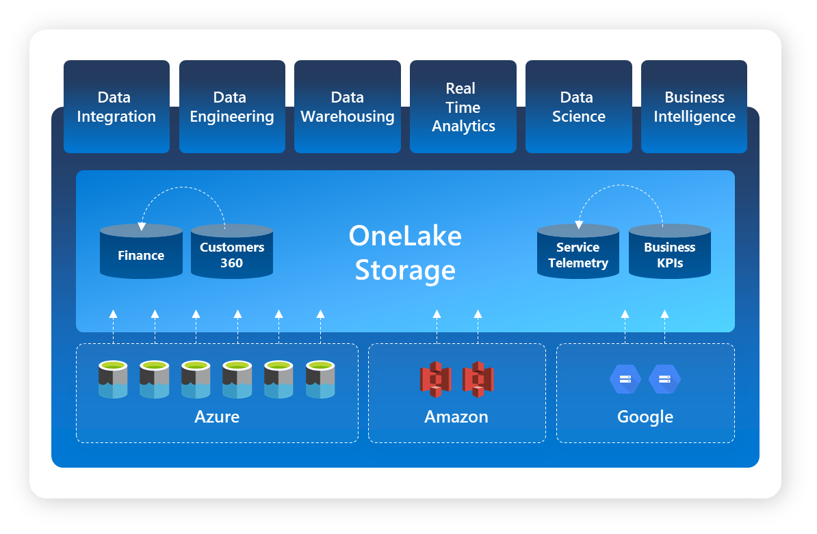
OneLake
OneLake is a single, unified, logical data lake for the whole organization
Data
Factory
Synapse Data
Engineering
Synapse Data
Science
Synapse Data Warehousing
Synapse Real Time Analytics
Power BI
Data Activator
OneLake
Single, Unified data lake solution:
Governed by Default: Every Fabric tenant comes with one OneLake, governed by default.
Open and Flexible: Built on Azure Data Lake Storage Gen2, OneLake supports various data types and integrates seamlessly with existing Azure services
Data Sharing with Shortcuts: Shortcuts facilitate data sharing across teams and domains without data duplication, connecting data across workspaces and locations
Multi-Engine Access: OneLake supports multiple analytical engines, such as T-SQL, Spark, and Analysis Services, all utilizing the same data in an open delta parquet format, eliminating the need for data copying

Slide 15
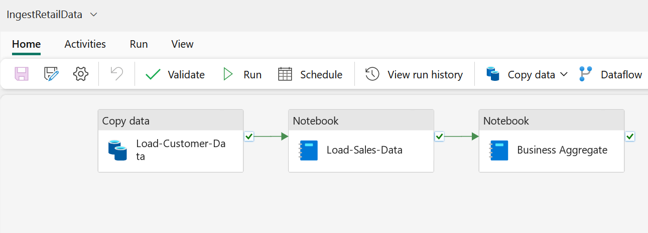
Data Factory
Data Factory in Microsoft Fabric offers a modern data integration experience, enabling both citizen and professional developers to efficiently ingest, prepare, and transform data from various sources
Data
Factory
Data Factory: Your Gateway to Advanced Data Integration
Ingest, Prepare, Transform: Seamlessly handle data from diverse sources (databases, data warehouses, Lakehouse, real-time data, and more)
Accessible for All: Designed for both citizen and professional developers
Lightning-Fast Data Movement: Utilize Fast Copy within Data Factory for rapid data transfer
Fueling Analytics: Easily bring data to your Microsoft Fabric Lakehouse and Data Warehouse for powerful analytics

Slide 16
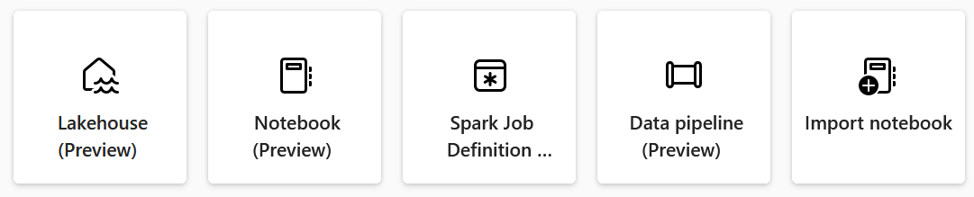
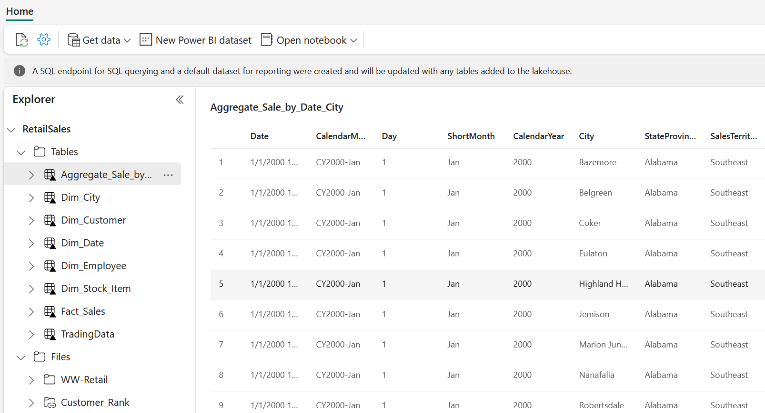
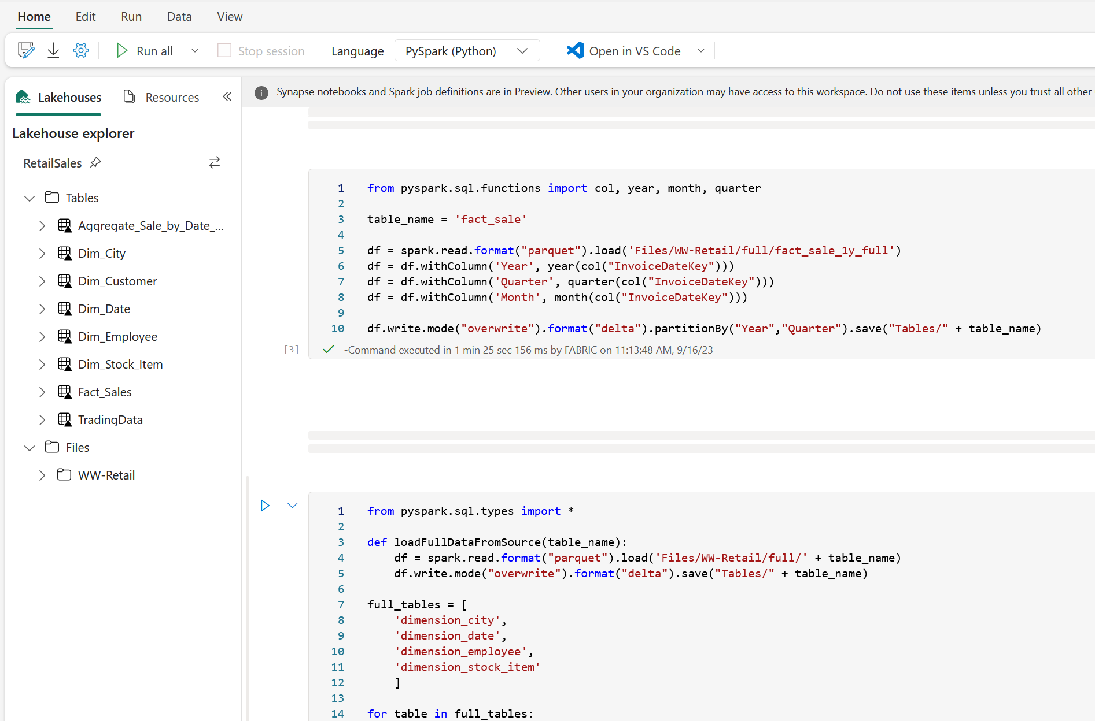
Data Engineering
Data engineering in Microsoft Fabric enables users to design, build, and maintain infrastructures and systems that enable their organizations to collect, store, process, and analyze large volumes of data
Synapse Data
Engineering
Data Engineering Capabilities:
Ensure accessible, well-organized, high-quality data
Create and manage data using a lakehouse
Design pipelines for seamless data copying
Utilize Spark job definitions for batch/streaming jobs
Leverage notebooks for code-based data tasks

Slide 17
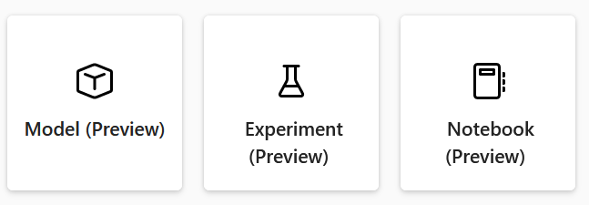
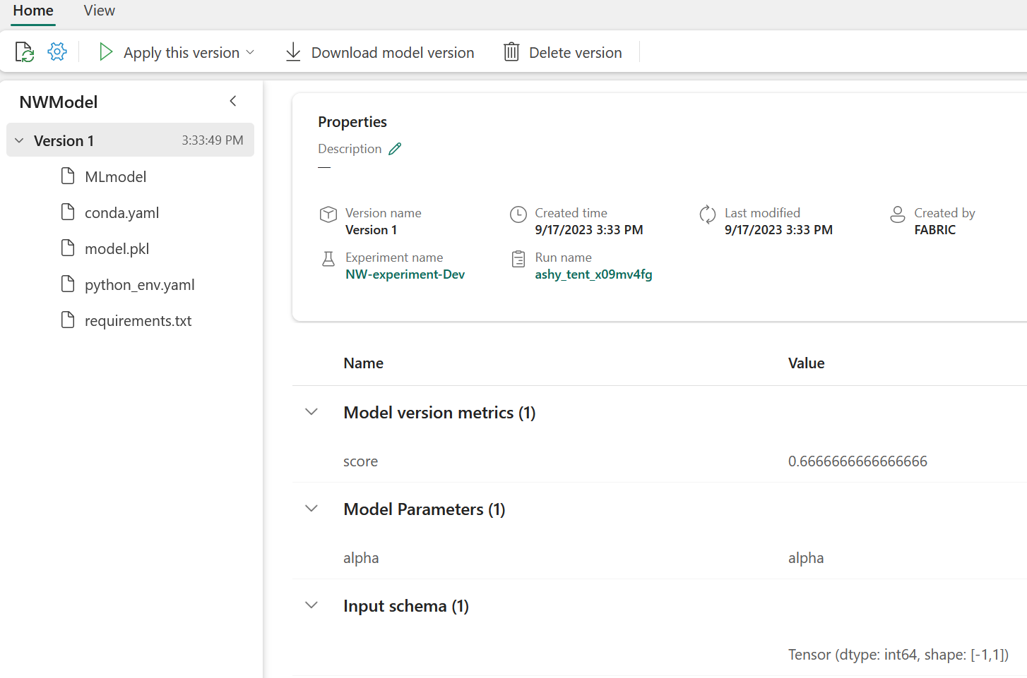
Data Science
Microsoft Fabric provides a comprehensive Data Science platform, enabling users to streamline end-to-end data science workflows, from data exploration and preparation to modeling and predictive insights, fostering data enrichment and valuable business insights
Synapse Data
Science
Data Science Workflows Empowered:
Microsoft Fabric facilitates end-to-end data science workflows
Enables data enrichment and business insights
Covers data exploration, preparation, cleansing, experimentation, modeling, scoring, and serving insights to BI reports
Unification of multiple ML frameworks and algorithms into a single API
Integration with pre-trained AI models from Azure AI services
Integration with Microsoft Fabric model registry
Predicted values written to OneLake and consumed in Power BI reports

Slide 18
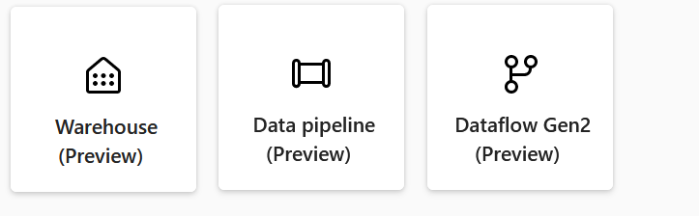
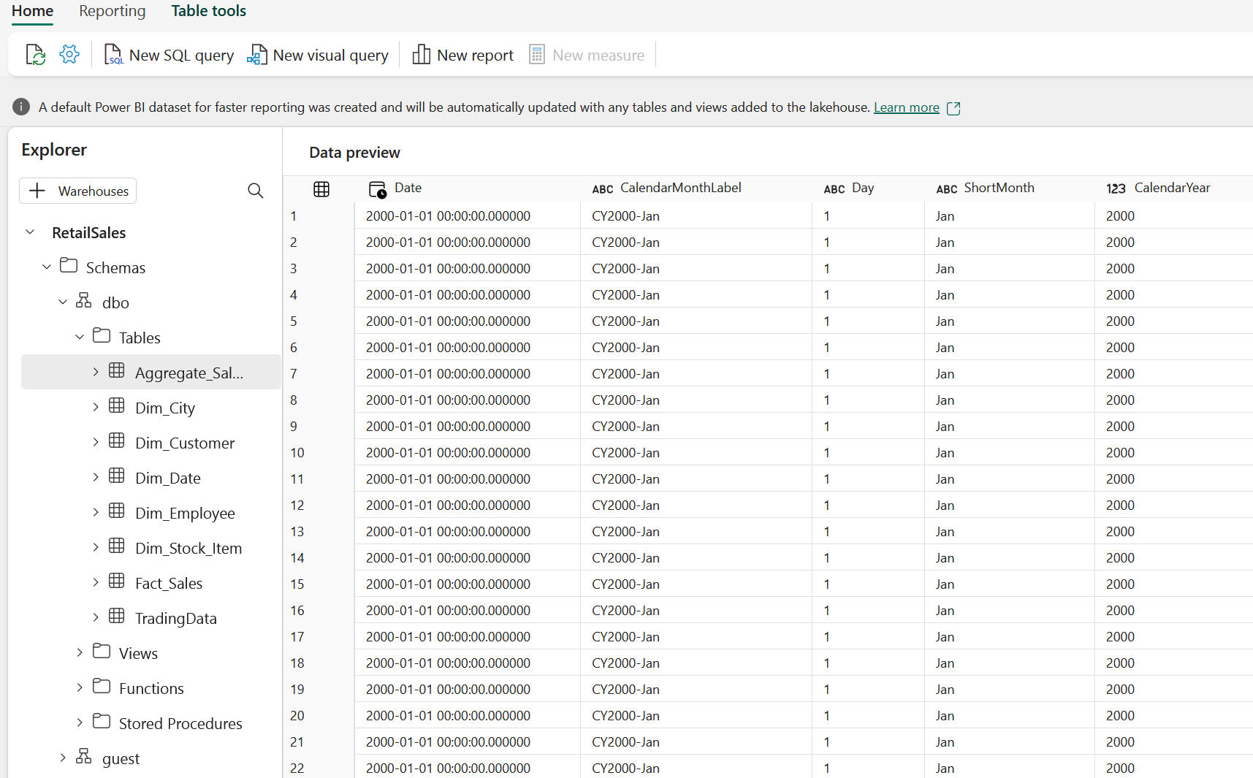
Data Warehouse
Simplified data warehousing with high-performance analytics while eliminating the complexities of configuration, making it an accessible and powerful solution for organizations
Synapse Data Warehousing
Lake centric data warehouse:
Enterprise-grade distributed processing engine
Industry-leading performance at scale
Eliminates configuration and management hassles
Seamless integration with Power BI for analysis and reporting
Microsoft OneLake as the centerpiece

Slide 19
Real Time Analytics
Real-Time Analytics in Microsoft Fabric simplifies data integration, democratizes data access, and empowers users, from citizen data scientists to advanced data engineers
Synapse Real Time Analytics
Real Time Analytics scaling up seamlessly:
Real-Time Analytics is a fully managed big data analytics platform
Simplifies Real Time Data Processing
Supports time series analysis and geospatial analytics
No-code experience with Eventstream
Kusto Query Language (KQL) database is scalable, capable of handling billions of records, and retains data for extended periods
Power BI reports from KQL queries

Slide 20

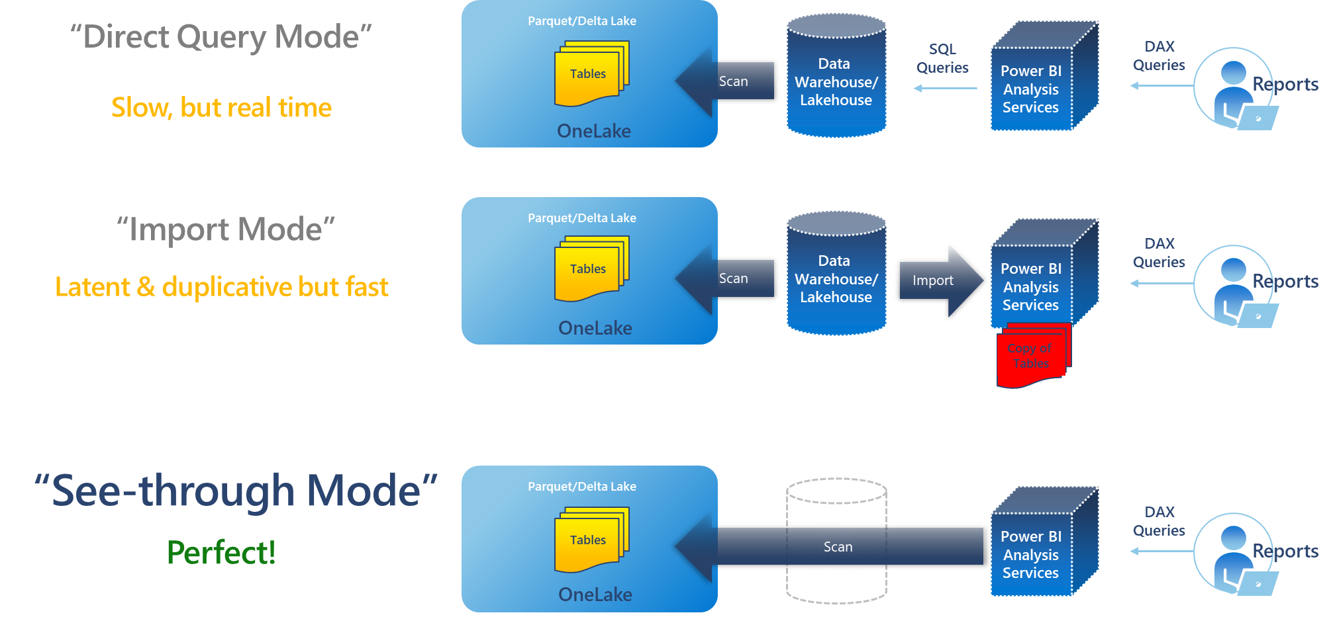
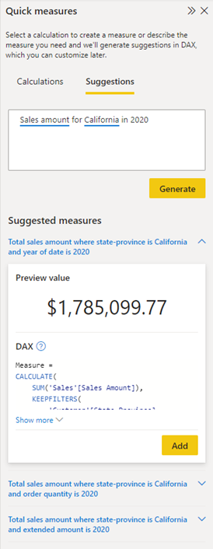
Power BI
Deliver compelling data experiences for end users, enabling them to take action based on insights
Power BI
Self Service Reporting Tool:
Turn your unrelated sources of data into coherent, visually immersive, and interactive insights
Easily connect to your data sources, visualize and discover
Quick measure suggestions assist creation of DAX
AI with Copilot in Power BI

Slide 21
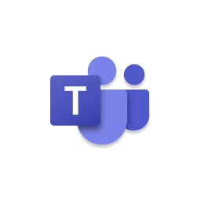


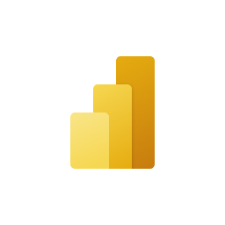


Data Activator
OneLake
Teams
Outlook
Data Activator
Power BI
Synapse Data Warehouse
No-code user experiences
Power Automate
Synapse Real Time Analytics
Custom
Models
Rules
Triggers
…
Real-time stream processing
…

Slide 22
Data Mesh
OneLake for all domains
Sales
Customer
A true hub & spoke data mesh across organizational data domains.
HR
IT
Marketing
Finance
Operations
Workspaces and artifacts for different data domains, contribute to building the same data lake.
Without data movement, data from different domains can be analyzed, blended and transformed together.
Data is secured and governed in one place while remaining easily discoverable and accessible to all who should have access across the organization.
Data can be certified by domain experts to enabling trust for data which is discovered.

